Slide 1

Master of Science in
Criminal Justice and Criminology
Information Session
Fall 2025

Slide 2
Agenda
Introductions
Why an MCJC Degree?
Program Overview
Curriculum and Culminating Experience
Other Program Information
Tuition & Funding Opportunities
Application Process
Q&A

Slide 3
Introductions

Slide 4
School of Public Affairs
Master of Criminology & Criminal Justice
Master of City Planning
Master of Public Administration

Slide 5
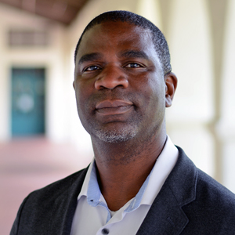
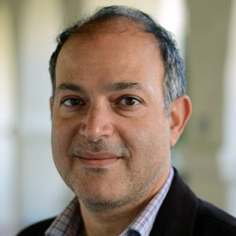
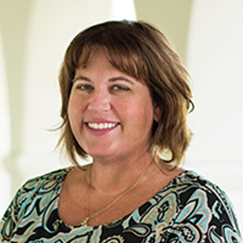
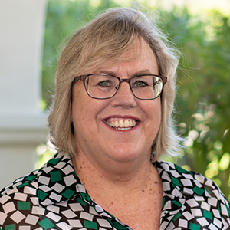
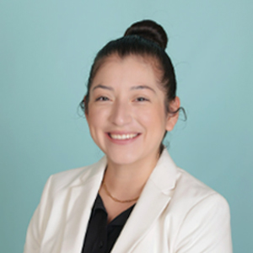
SPA Faculty & Staff
Dr. Rod Colvin
Director, School of Public Affairs
Professor of Public Affairs
Dr. Mounah Abdel-Samad
Associate Director, School of Public Affairs
Associate Prof. of Public Administration
Julie O’Connor-Quinn
Administrative Coordinator, School of Public Affairs
Kathee McBride
Administrative Support Assistant, School of Public Affairs
Tania Mejia-O’Donnell, M.S.
Graduate Programs Coordinator, School of Public Affairs

Slide 6
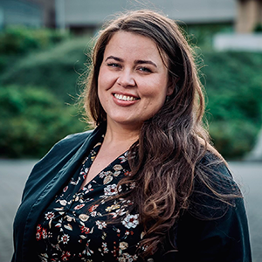
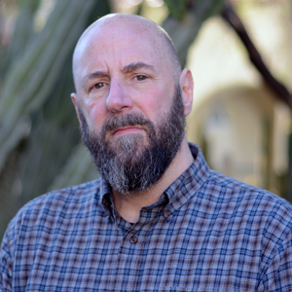
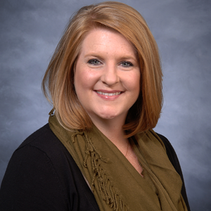
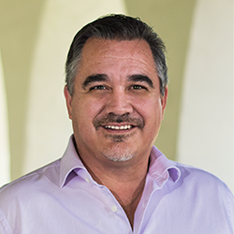
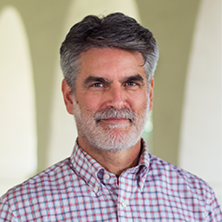
MCJC Faculty
Dr. Paul Kaplan
Professor of Criminal Justice
Dr. Kim Kras
Associate Professor of Criminal Justice
Graduate Faculty Advisor
Capstone Coordinator
Dr. Jeffrey McIlwain
Associate Professor of Criminal Justice
Dr. Alan Mobley
Associate Professor of Criminal Justice
Associate Director, Institute for Dialogue and Social Justice

Slide 7
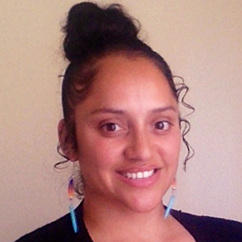
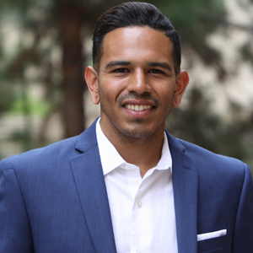
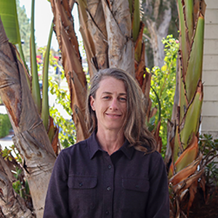
MCJC Faculty
Dr. Tereza Trejbalova
Assistant Professor of Criminal Justice
Dr. Erica Redner-Vera
Assistant Professor of Criminal Justice
Dr. Burrel Vann, Jr.
Associate Professor of Criminal Justice
Dr. Megan Welsh Carroll
Professor of Criminal Justice
Director, Institute for Innovative Governance

Slide 8
Why Get a Masters in Criminology & Criminal Justice?

Slide 9
Career Opportunities
Criminal Justice Administrator
Corrections Manager
Crime Analyst
Law Enforcement Officer
Probation and Parole Manager
Juvenile Justice Specialist
Victim Advocate
Criminal Justice Educator
Researcher
Policy Maker

Slide 10
Reasons to Consider a Masters as a Criminal Justice Undergrad
Deepen Expertise: Gain advanced knowledge in criminological theory, criminal justice policy, and research methods.
Career Advancement: Open doors to leadership roles such as criminal justice policy analyst, federal agent, or researcher.
Specialization Opportunities: Focus on areas like corrections, law enforcement, or juvenile justice.
Impactful Research: Engage in research projects to influence criminal justice reforms and practices.
Higher Earning Potential: Advanced degrees can lead to better salaries in the field.
Preparation for Doctoral Studies: Ideal for those interested in pursuing a Ph.D. in criminal justice or criminology or related field or a JD.

Slide 11
Reasons to Consider a Masters as a Public Administration Undergrad
Expand Career Horizons: Transition into criminal justice fields such as federal law enforcement, crime analysis, or justice policy advising.
Policy Development: Learn how criminal justice policies are designed and implemented, complementing administrative expertise.
Diversify Skill Set: Gain insights into criminal justice systems and practices, broadening understanding of public safety issues.
Community Impact: Focus on addressing challenges such as criminal justice reform and public safety administration.
Complementary Knowledge: Blend administrative skills with a deeper understanding of criminology to influence criminal justice policies effectively.

Slide 12
Program Overview

Slide 13


Program Overview
36-unit Curriculum (12 Courses)
Culminating Experience
Nine core courses (27 units)
Two elective courses (6 units)
Culminating experience (3 units)
“Plan A” - Thesis
“Plan B” - Capstone

Slide 14
Core Courses (27 units required)
CJ 601 | Seminar in Administration of Justice | 3 units
CJ 602 | Seminar in Comparative Criminal Justice Systems | 3 units
CJ 603 | Seminar in Community and Restorative Justice | 3 units
CJ 604 | Seminar in Criminal Justice and Urban Administration | 3 units
CJ 605 | Seminar in Juvenile Justice and Youth Violence | 3 units
SOC 743 | Seminar in Criminology and Criminal Justice Theory | 3 units
PA 604 | Methods of Analysis in Public and Urban Affairs | 3 units
PA 605 | Seminar in Applied Research | 3 units
PA 606 | Seminar in Quantitative Approaches to Public Administration | 3 units

Slide 15



Electives (6 units required)
Any 500- or 600-level course offered by the School of Public Affairs
Internship (CJ 796)
Relevant, graduate-level coursework from other campus department
Public Admin, City Planning, or Criminal Justice/Criminology
CJ 510 - Contemporary Issues in Criminal Justice
CJ 531 - Probation and Parole
CJ 550 - Study Abroad: Criminal Justice
CJ 570 - Organized Crime: Domestic and International Perspectives
CJ 796 - Internship in Criminal Justice Units
P A 660 - Administration and Public Policy Development
Identify a local organization or work with our Graduate Programs Coordinator to identify an internship
Complete requisite paperwork
Complete 120 hours for 3 units or 240 hours for 6 units
E.g., Political Science, Sociology, Psychology, Business, Economics
Talk with course instructor, clear with MCJC Faculty Advisor

Slide 16
Sample Course Plan
COURSE | UNITS | TITLE
FALL – Year 1
PA 604 | 3 | Methods of Analysis in Public and Urban Affairs
CJ 601 | 3 | Seminar in the Administration of Criminal Justice
SOC 743 | 3 | Seminar and Criminology and Criminal Justice Theory
SPRING – Year 1
PA 606 | 3 | Quantitative Approaches to Public Administration
CJ 603 | 3 | Seminar in Community and Restorative Justice
CJ 604 | 3 | Seminar in Criminal Justice and Urban Administration
FALL – Year 2
CJ 602 | 3 | Seminar in Comparative Criminal Justice Systems
PA 605 | 3 | Seminar in Applied Research
Elective | 3 | 3 unit course
SPRING – Year 2
CJ 605 | 3 | Seminar in Juvenile Justice and Youth Violence
Elective | 3 | 3 unit course
PA 795 or CJ 799A | 3 | Capstone or Thesis

Slide 17
Culminating Experience

Slide 18
Culminating Experience
Thesis
(Plan A)
CJ 799A
Empirical analysis of issue related to criminology and criminal justice
Independent study with support from thesis committee
Capstone (Plan B)
PA 795
  Community-based research study
  Group-based with support from Faculty Supervisor

Slide 19
Recent Thesis Projects
“A Tale Of Two Communities: Social Disorganization Markers’ Effect On Police Behavior In A Border City”, by Sheri Gudez (Spring 2023)
“Veterans Treatment Courts and Their Functions: An Aristotelian Take on the Court’s Conscience”, by Grace Lemoyne (Spring 2023)
“Centering Women’s Experiences And Narratives Within The Pathways To Desistance”, by Laura Murray (Spring 2021)

Slide 20
Recent Capstone Projects
Reintegration through Circles of Accountability and Support (COSA): Meeting the Needs of Core Members
  Research Team: Alicia Isla, Larissa Rodriguez, Abigail Sosa Ramos, Kimberly Villegas
  Partner Agency: COSA San Diego
Educational and Vocational Program Accessibility in the California Department of Corrections and Rehabilitation (CDCR)
  Research Team: Martha Ponce, Gabe Collins, Madison Hatfield, Yaritzel Guerrero-Montoya
  Partner Agency: San Diego Regional Policy & Innovation Center
Building the RANJE Mapping Tool for Mitigation in Public Defense
  Research Team: Angelina Trigueros, Estefani Garcia, Josh Chevertte, Nayelli Mendoza, Rosa Cordova
  Partner Agency: Alternate Public Defenders - County of San Diego
Fair Fare Solutions: Addressing the Implementation Gap in San Diego Metropolitan Transit System's (MTS) Fare Diversion Program
  Research Team: Zaccary Bradt, Ian Brazill, Justine Murray
  Partner Agency: San Diego Metropolitan Transit System (MTS)

Slide 21
Other Program Information
Class Structure​
  Classes usually range from 10-20 students, allowing for focused study and collaboration.​
  Classes are designed with professionals in mind. All grad courses are in the evening either from 4-6:40 p.m.or 7-9:40 p.m.​
  Full time status at the graduate level is 9-12 units per semester.​
Assistantships​
  Teaching/Research Assistantships are available ​
  Typically 5-10 hours per week​
Professional Development Opportunities​
  Professional Memberships​
  Professional Conferences​
  Trainings and workshops within SPA and across SDSU​

Slide 22
Graduate-Specific Resources
Office for Graduate Life and Diversity (GLAD)
  GLAD is dedicated to supporting all graduate students' success and promoting diversity, equity, and inclusion in SDSU's graduate programs. They offer various personal, professional, financial, and social resources to enrich the graduate experience. Services include the Graduate Student Writing Center, mental health support, and workshops.
Graduate Student Association (GSA)
  The GSA focuses on the programmatic, policy, and campus life needs of graduate students. They provide resources such as scholarships, funding for student organizations, and wellness support.
University Library
  The University Library offers services for graduate students to support their research, scholarly and creative activities (RSCA).

Slide 23
Other Campus Resources
Wellness and Support Services
Counseling and Psychological Services
Student Disability Services
Economic Crisis Response Team (ECRT)
Instructional Technology Services (ITS)
Student Centers and Organizations
Joan and Art Barron Veterans Center
Pride Center
International Student Center
Student Health Services
Student Organizations
Other Services
Academic Services
Cultural Centers
Writing Center
Employment Services
Thesis and Research Related Services
Economic Resources

Slide 24
Tuition and Funding Opportunities

Slide 25
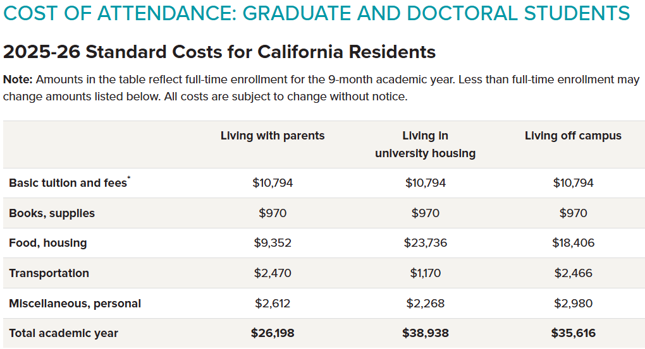
Tuition and Fees

Slide 26
Tuition and Fees
Non-Residents and International Students: Approximately $33,994 per academic year.
For more information on tuition and fees, please visit the Office of Financial Aid's page for graduate and doctoral students and the SDSU Bursar's Office. The Bursar’s page provides information on basic tuition, in-state tuition, out-of-state, and international student fees.
Note: These figures are subject to change. For the most current information, refer to SDSU's official tuition and fees page.

Slide 27
FAFSA for Graduate Students
FAFSA: Graduate students can complete the FAFSA, but their aid options are limited to:
  Federal Direct Unsubsidized Loans: Up to $20,500 per academic year, with interest accruing immediately upon disbursement.
Work-Study Programs: Some graduate students may qualify for federal work-study opportunities.
No Pell Grants or Subsidized Loans:
  Graduate students are not eligible for Pell Grants or Federal Direct Subsidized Loans, which are reserved for undergraduates with financial need.
Independent Status:
  Graduate students are considered independent for FAFSA purposes, meaning parent income is not included in determining financial need.
Submission Process:
  The FAFSA is still submitted online at studentaid.gov.
  You’ll need to include your own financial information and any relevant tax data from the prior year.
Talk to the Office of Financial Aid for more information.

Slide 28
Funding Opportunities
Aztec Scholarships
Office of Graduate Studies
School of Public Affairs Scholarships
External Funding Bodies

Slide 29
Application Process

Slide 30
Application Process
University Application: Submit via Cal State Apply by February 1, 2026.
Transcripts: Send official transcripts to Graduate Admissions by February 15, 2026.
Program Application: Complete the MCJC application through Slate by March 1, 2026.
  Two Letters of Recommendation
  Unofficial Transcripts
  CV (not resume)
  Personal Statement: (500-word essay about your professional and educational goal)
  Writing Sample: Paper that displays your academic and/or professional writing skills. Examples of useful writing samples include: A paper written for a college course that demonstrates your ability to synthesize and/or analyze information or a report or or similar professional work product that showcases your writing, research or analysis skills.

Slide 31
Application Materials: Letters of Recommendation
Two recommendation letters from professors, relevant employers, internship supervisors, or others familiar with your academic abilities and accomplishments.
Ideal recommenders include:
  Professors
  Internship supervisors
  Academic mentors
  Professional supervisor or employer, please ensure that the individual is able to speak in depth about your skills, work ethic, and accomplishments relevant to the field of criminal justice and criminology.

Slide 32
Application Materials: Unofficial Transcripts
Submit copies of your transcripts to Slate.
This does not replace the formal, official transcript submitted to Graduate Studies!

Slide 33
Application Materials: Curriculum Vitae
A Curriculum Vitae (CV) is an overview of your life's accomplishments, most specifically those that are relevant to the academic realm.
A CV includes sections describing:
Contact Information
Education
Research interests
Publications & Presentations
Experience (e.g., Teaching, Research, Volunteer, Practical)
Professional affiliations
Certifications and specific skills

Slide 34
Application Materials: Statement of Purpose
~500 word statement containing a narrative about:
  Who you are and your background,
  Your reasons for choosing the Masters of Science in Criminal Justice & Criminology program
  Your academic and/or professional readiness for graduate school,
  Your professional aspirations
  Specific area(s) of interest in criminal justice or faculty members you might work with.
Please complete your statement in a PDF to show up properly in the application

Slide 35
Application Materials: Writing Sample
Submit one writing sample in PDF format that displays your academic and/or professional writing skills your ability to synthesize and/or analyze information, your writing, research or analysis skills
Examples of writing samples include:
  Paper written for a college course
  Peer-reviewed or non-peer-reviewed manuscript
  Research report
  Professional report

Slide 36
Final Note Before Q&A​
For deeper details, we encourage you to explore our website:​
  Course list and descriptions​
  Program handbook​
  Culminating experience options​
  FAQ guide​
  Funding and tuition information​
  Step-by-step application instructions​
If, after the presentation, you still have specific questions, please check the site first andthen email Dr. Kras and I with the specific questions. We are happy to help!
We’ll open the floor for Q&A now.​

Slide 37
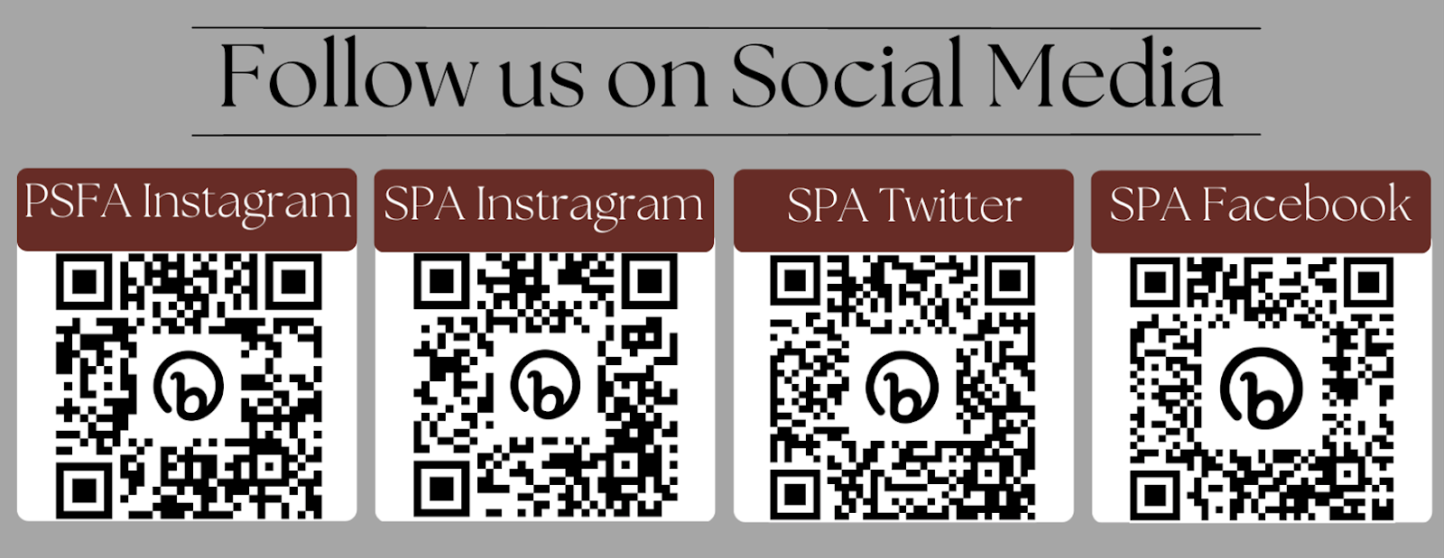
Questions?

